Slide 1
PARASITOLOGY (BIOL 460)
UNIT 8 B
PARASITIC INSECTS-FLEAS (Order Siphonaptera)

Slide 2
Parasitic Insects: Fleas (Order Siphonaptera)
Of all of humanity’s major diseases and important insect pests, the combination of flea and plague bacillus has had the greatest impact on human history.
Fleas are small insects in length, from less than a millimeter to a few millimeters.
There are about 2500 species, most of which are parasites of mammals and about 100 species are of birds.
They are heavily sclerotized, bilaterally flattened and secondarily wingless-evolutionary loss of wings is a common feature of parasitic insects

Slide 3
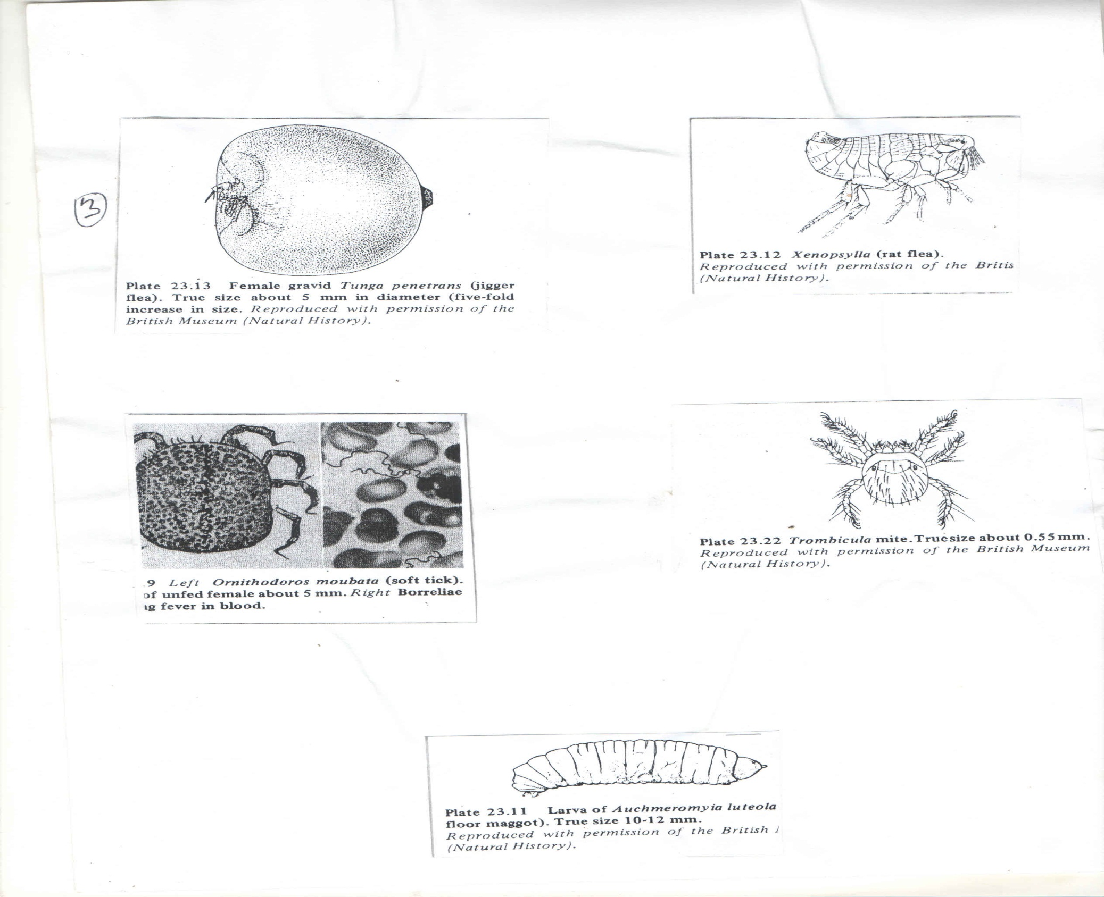

Slide 4
Parasitic Insects: Fleas (Order Siphonaptera) cont’d
Fleas are commonly reddish-brown to black but some are tan or yellow
Their mouthparts are of the piercing-sucking type
Adults feed exclusively on blood
Larvae usually are not parasitic but feed on debris and materials associated with the nest or surroundings of the host, especially faeces of adult fleas
Fleas move by a characteristic jumping mechanism

Slide 5
Parasitic Insects: Fleas (Order Siphonaptera) cont’d
Morphology
The head of a flea is broadly joined to its thorax and often bears a general ctenidium.
Ctenidia are series of rather stout, peglike spines often found on the posterior margin of the first thoracic tergite (pronotal ctenidium), as well as on the head.
Ctenidia and backwardly directed body setas are adaptations that help a flea retain itself among the fur or feathers of its host.

Slide 6
Parasitic Insects: Fleas (Order Siphonaptera) cont’d
The width of the space between adjacent spine tips in ctenidia of a particular species of flea is correlated to the diameter of the hairs of its usual host, being slightly wider than the maximal diameter of its host’s hair.
Thus, in backward movement, hairs tend to catch between ctenidial spines producing some resistance.
Because of this resistance to being dragged backwards, removal of a flea by host grooming or preening is relatively difficult.

Slide 7
Parasitic Insects: Fleas (Order Siphonaptera) cont’d
However, these structures do not impede the forward movement of the flea between the hairs of the host.
Eyes, when present, are simple and have a single, small lens, ocelli are absent.
There is a peculiar sensory organ near the posterior end called the PYGIDIUM that apparently functions to detect air currents.
Fleas have strong hindlegs, much larger than the other two pairs and are modified for jumping.

Slide 8
Development
Development of fleas is holometabolous and larvae, thus, are quite different in form and habits from adults.
Females usually oviposit while on a host but the eggs are not sticky and so drop off, typically into the nest or hair, where there is a supply of detritus and flea faeces on which larvae feed.

Slide 9
Development cont’d
High humidity tends to favour egg laying; under favourable conditions eggs hatch in 2-21 days;
there are three (usually) larval instars that take 9-15 days and pupae take a week to complete development.
Low temperature and those as high as a host’s body temperature retard development; low temperature can extend larval period to more than 200 days and pupal stage to nearly a year

Slide 10
Development cont’d
Larval cannot close their spiracles, hence, are sensitive to low humidity;
they are white, legless, and eyeless, resembling maggots of some Diptera;
they have chewing mouthparts and stout body hairs
Pupae spin loose silken cocoons from salivary secretions, using debris from their surroundings and incorporating it into the cocoon

Slide 11
Development cont’d
In common with other lain parasites such as bedbugs and in contrast with lice, fleas can survive long periods as adults without food, particularly under conditions of high humidity.
Such longevity has epidemiological importance because it allows flea-transmitted pathogens to survive long periods when vertebrate hosts are absent.

Slide 12
Host Specificity
Although fleas may have preference for certain hosts, they are not generally host-specific
Most can transfer from a main host to another or to a host of a different species;
their common names, such as rat flea, chicken flea, human flea, refer to their preferred host and do not imply they attack/ live on that host exclusively.

Slide 13
Host Specificity cont’d
There are over 50 genera of fleas of medical importance globally.
Fleas are grouped into four categories on the basis of the degree of attachment to a host:
Those that are seldom on a host but occur abundantly in the nest of the host, e.g. some rat fleas e.g. Conorhinopsylla and Megarthroglossus spp.

Slide 14
Host Specificity cont’d
II. Those which spend most of their time on the host as adults, but can transfer easily from one host to another.
III. Those which attach permanently to the host skin by their mouthparts, e.g. the female stick tight fleas, Echidnophaga gallinacea

Slide 15
Host Specificity cont’d
IV. Those which borrow beneath host skin and become stationary, intracutaneous, and subcutaneous parasites,
e.g. the female Chigoes, or Jigger flea.
Such fleas that become permanently attached play little or no role in disease transmission
There are some variations to these four categories due to the adaptations to their hosts and the environments in which they are found.

Slide 16
Families of the Order Siphonaptera
Of Medical importance
Families of the order that are of medical importance, include:
Families Ceratophyllidae and Leptopsyllidae
Members of these families are mainly rodent and bud fleas, e.g.
Nosopsyllus fasciatus is a common parasite of domestic rats and mice (Rattus and Mus spp) in the northern hemisphere, but also reported on other hosts, including humans

Slide 17
Families Ceratophyllidae and Leptopsyllidae cont’d
It may transmit plague from rat to rat but not important in this regard as far as humans are concerned because it does not bite humans, usually.
Ceratophyllus niger and C. gallinae are bird fleas, but can bite humans
Leptopsyllus segnis is the European mouse flea but is also common in the US; it is more common on species of Rattus than on Mus.
It can be infected with plague but it is not an important vector as it does not readily bite humans.

Slide 18
Family Pulicidae
This family consists of species of medical and veterinary importance
Pulex irritans-the human flea, has been reported as infecting pigs, dogs, coyotes, prairie dogs, ground squirrels, and burrowing owls
P. irritans can transmit plagues

Slide 19
Family Pulicidae cont’d
Echidnophaga gallinacea is an important pest of poultry but also attacks cats, dogs, horses, rabbits, humans and other animals.
Its name is stcktight flea because it burrows its fascicle in a host’s skin and remains in place.

Slide 20
Family Pulicidae cont’d
It prefers to attach in areas with few feathers, such as the comb, wattles, around the eyes and around the anus of its host;
an infestation causes ulcers into females deposit eggs; larvae hatch in the ulcers but then drop to the ground to develop off the host; heavy infestations may kill chickens.

Slide 21
Family Pulicidae cont’d
Ctenocephalides canis and C. felis are dog and cat fleas respectively.
However, both species attack cats and dogs as well as human and other mammals
C. felis is especially opportunistic as it has been reported to infect horses, foxes, mongooses, koalas, skunks and poultry.
It is also more common than C. canis on dogs in North America

Slide 22
Family Pulicidae cont’d
Both species can be very annoying pests of humans, especially when dogs and cats are kept at home as pets
Cats fleas deposit most of their eggs at the time when their hosts are least active (i.e. midnight to very early morning) and most likely to be their resting places.
Flea faeces make up more than 40% of the debris that falls off infested cats and so are also concentrated in these areas (the faeces serve as larval food).

Slide 23
Family Pulicidae cont’d
Like many insects, cat fleas and their faeces are allergenic and may contribute to the allergenicity of house dust; at least 15 different proteins from C. felis are allergenic.
Xenopsylla cheopis is the oriental or tropical rat flea;
it is almost cosmopolitan on Rattus spp., except in cold climates

Slide 24
Family Pulicidae cont’d
X. cheopis is of enormous public health significance because it is the most important vector of plague and of murine typhus;
X. brasiliensis, an African species that has become established in S. America and India is probably an important vector of plague in Kenya and Uganda.

Slide 25
Family Tungidae
Tunga penetrans, commonly known as Chigoe, Jigger, Chigger, Chique or the Sandflea, is one of 10 species feeding on humans
and many other mammals, especially Swine; other domestic animals, rodents, anteaters and armadillos are also parasitized;
it is the most common of the 10 species known.

Slide 26
Family Tungidae cont’d
T. penetrans is believed to have originated from Central and South America and the West Indies from where it was introduced to Africa in the 17th Century
and again in the 19th Century; it spread all over tropical Africa and then to India

Slide 27
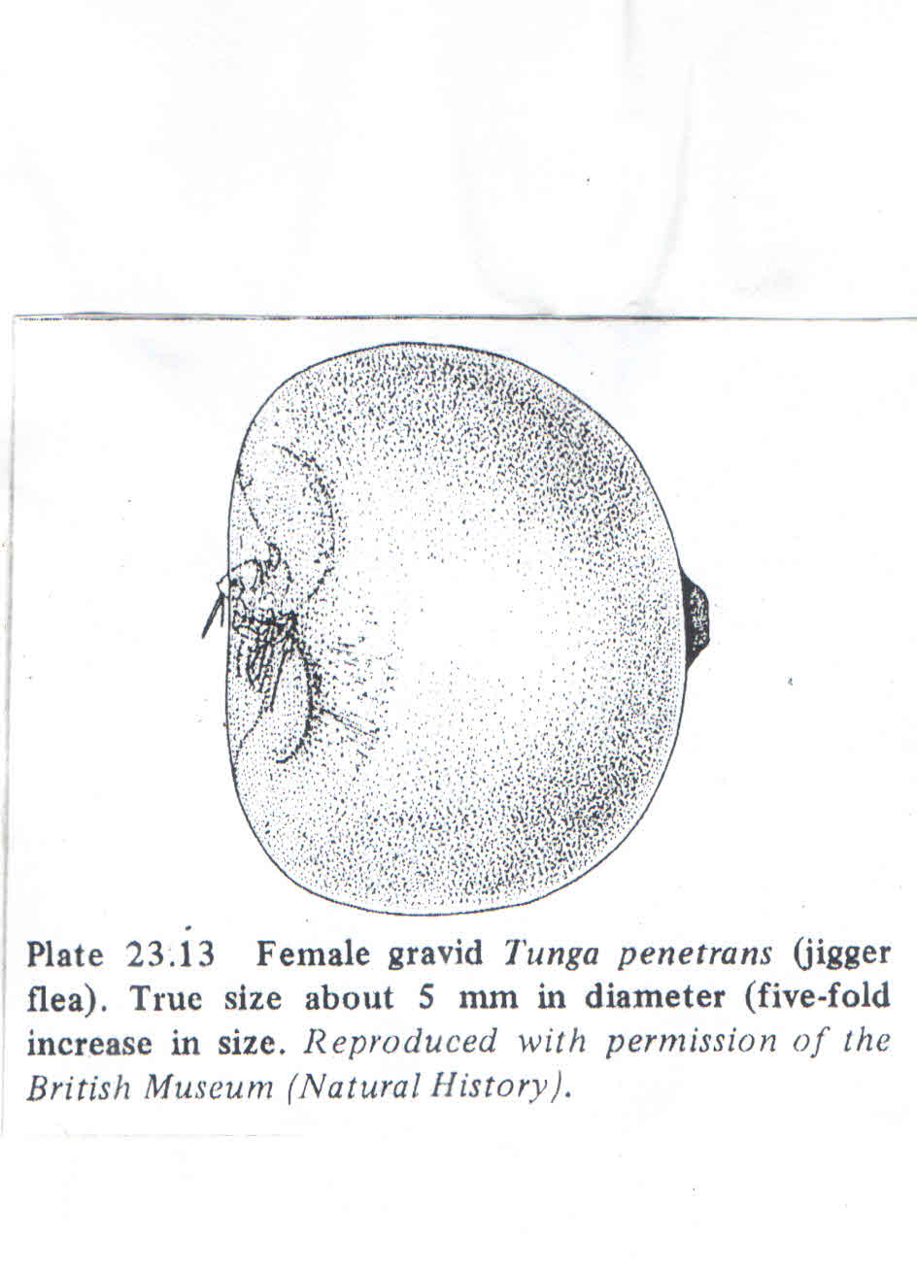

Slide 28
Family Tungidae cont’d
Female chigoes penetrate the skin most commonly around the base of the nails of the feet and hands or between the toes.
Only a small aperture through the skin is left to communicate with the outside
Males do not penetrate host skin, but copulate with a female outside the body of the host and it is the pregnant female that burrows into the skin of the host.

Slide 29
Family Tungidae cont’d
On entry into the host skin, the barely 1.0 mm long flea gradually expands to about the size of a pea; the body is enclosed in a sinus, into which she lays her eggs
After hatching, larvae exit through the aperture and develop on the ground.
The infection causes extreme irritation, itching, pain, inflammation and tissue damage leading to secondary bacteria infection; tetanus and gangrene may complicate the condition

Slide 30
Family Tungidae cont’d
Treatment involves surgical removal of the fleas and careful sterilization and dressing of the wounds
Human tungiasis is significant health problem in poor communities of warmer climates.
There may be seasonal fluctuations, with peak prevalence of over 50% during the dry season; pets and rats serve as reservoirs in endemic communities.

Slide 31
Fleas as Vectors of Plague and Typhus
Plague
Also known as pest and black death is caused by a bacterim, Yersinia pestis (formerly known as Pasteurella pestis, which releases two potent toxins that produce identical serious effects
Some animals, such as rats and mice, are more sensitive to these toxins than other animals such as rabbits, dogs, monkeys and chimpanzees

Slide 32
Plague cont’d
There is evidence that the toxins act on mitochondrial membranes of susceptible animals, inhibiting ion uptake and interfering with normal functioning of the respiratory chain
One toxin is a plasmid-encoded phospholipase that is required by Y. pestis before it can survive in the gut of the flea.

Slide 33
Plague cont’d
The plague pandemic of the 14th Century across Europe, took 25 million lives (¼ of the population at that time).
Plague is essentially, a disease of rodents; humans contract it through flea bites, especially, of X. cheopis, as follows:
Bacteria are taken in by a flea along with its blood meal and they multiply in the flea’s gut and block the proventricular teeth.

Slide 34
Plague cont’d
On the next feed, a new blood meal cannot pass this obstruction and becomes contaminated by bacteria and is then regurgitated back into the bite wound.

Slide 35
Plague cont’d
There are three main clinical forms of plague, namely:
1. Bubonic plague
There is formation of definite bubo (swollen lymph nodes in the groins or armpits); they are hard, tender, and filled with bacteria and may rupture to the outside; it is 25-50% fatal, if untreated.

Slide 36
Plague cont’d
2. Pneumonic plague
This is a condition in which the lungs are most heavily involved, producing a pneumonia-like disease that develops rapidly, and is highly contagious to other people.

Slide 37
Plague cont’d
3. Primary Septicaemic Plague
This is a generalized blood infection with little or no lymph node swelling apparently because the blood is invaded too rapidly for typical nodal inflammation to develop.
However, secondary septicaemc plague occurs when an infection breaks out of lymph nodes

Slide 38
Plague cont’d
Y. pestis can infect most organs, resulting in massive tissue destruction
The incubation period after a flea’s bite is usually 2-6 days, followed by a chill and rapidly rising temperature to 39.5°C and 40°C
Lymph nodes draining an infection site swell, becoming haemorrhagic and often necrotic

Slide 39
Plague cont’d
Damage to vascular and lymphatic endothelium in many parts of the body leads to petechial and diffuse haemorrhages.
At first there is mental dullness, followed by anxiety or excitement and then delirium or lethargy and coma.

Slide 40
Murine Typhus
Also called Endemic or flea-borne typhus is caused by Rickettsia mooseri (R. typhi) which is morphologically indistinguishable from R. prowazekii
It occurs in warmer climates.
Control of Fleas
Within habitations, one should keep debris that harbours larval fleas to a minimum

Slide 41
Murine Typhus cont’d
Some persistent pesticides (e.g. Diflubenzuron which inhibits C. felis development) may be applied to places such as under carpets, in floor crevices and in pet bedding.
Pyriproxyfen and Methoprene make fleas to lay infertile eggs.
Use of light traps with yellow green filters to which fleas respond positively

Slide 42
Murine Typhus cont’d
Keeping areas where livestock are maintained tidy and free from debris, manure and other litter as possible
Use of insecticidal flea powders on dogs and cats, with repeated application when necessary
Personal protection by use of insect repellent creams on the body or application of the repellents to cracks, crevices etc indoors and outside.

